Slide 1


Introduction to Python
Python is a versatile, high-level programming language that is widely used for a variety of applications, from web development to data analysis and machine learning. It is known for its simple and readable syntax, making it an excellent choice for beginners and experienced programmers alike.
by Mohammad Javad Sharifi

Slide 2

Python Syntax and Basic Data Types
Python's syntax is designed to be easy to read and write, with a focus on readability and maintainability. In this section, we'll explore the basic data types in Python, such as integers, floats, strings, and booleans, and learn how to declare and work with variables.

Slide 3

Control Flow and Conditional Statements
1
If-Else Statements
Conditional statements allow you to execute different blocks of code based on specific conditions.
2
Loops
Loops, such as for and while loops, enable you to repeatedly execute a block of code until a certain condition is met.
3
Logical Operators
Python provides logical operators like and, or, and not to combine multiple conditions in your code.

Slide 4
Functions and Modules
Functions
Modules
Standard Library
Functions are reusable blocks of code that can accept input parameters and return values. They help organize your code and make it more modular.
Modules are files containing Python code that can be imported and used in other Python scripts. They allow you to organize and share code across your projects.
Python comes with a vast standard library of pre-built modules, providing a wide range of functionality for tasks like file I/O, networking, and more.

Slide 5




Object-Oriented Programming in Python
Classes
Python supports object-oriented programming, allowing you to create custom classes and objects with their own attributes and methods.
Inheritance
Inheritance enables you to create new classes based on existing ones, inheriting their properties and behaviors.
Encapsulation
Encapsulation is the principle of bundling data and methods into a single unit, providing data abstraction and information hiding.
Polymorphism
Polymorphism allows objects of different classes to be treated as objects of a common superclass.

Slide 6
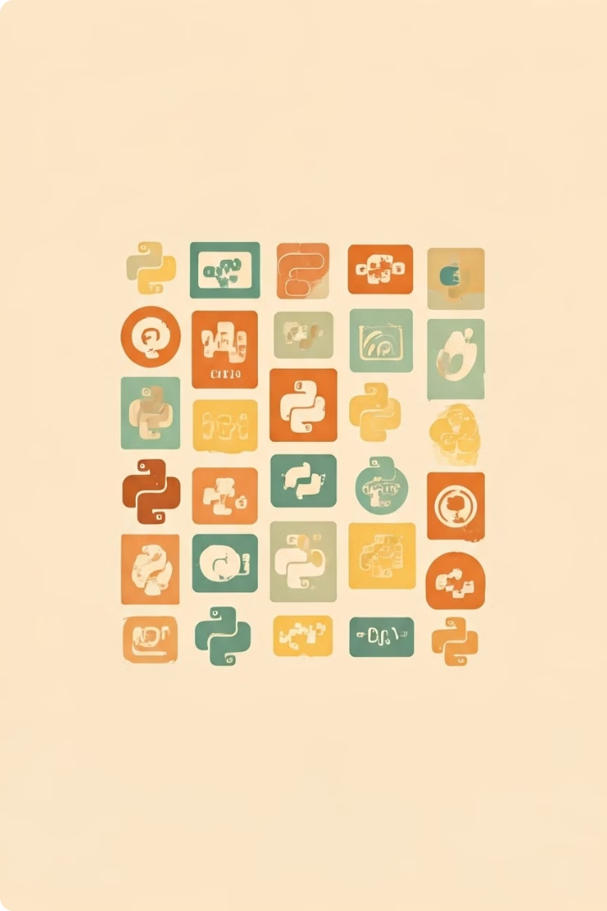
Python Standard Library
1
File I/O
Python's standard library includes modules for reading, writing, and manipulating files and directories.
2
Math and Scientific Computing
Python provides a rich set of mathematical and scientific computing functions and modules, such as NumPy and SciPy.
3
Web Development
Python's standard library includes modules like Flask and Django for building web applications and APIs.
4
Data Analysis and Visualization
Python's data analysis and visualization capabilities are enhanced by libraries like Pandas and Matplotlib.

Slide 7


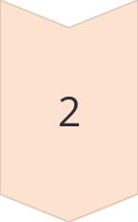
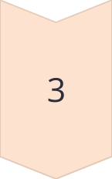
File I/O and Exception Handling
Reading Files
Python provides built-in functions like open() and read() to read data from files.
Writing Files
The open() function can also be used to write data to files, with methods like write() and close().
Exception Handling
Python's try-except blocks allow you to handle exceptions that may occur during file I/O operations.

Slide 8

Python Packages and Virtual Environments
Packages
Virtual Environments
Python packages are collections of modules that can be installed and used in your projects, providing additional functionality.
Virtual environments allow you to create isolated Python environments with their own dependencies, preventing version conflicts.
Package Managers
Deployment
Tools like pip and conda make it easy to install, upgrade, and manage Python packages and their dependencies.
Virtual environments also simplify the deployment of Python applications, ensuring consistent environments across different systems.

Slide 9

Python for Data Analysis and Visualization
NumPy
Powerful library for numerical computing, including support for large, multi-dimensional arrays and matrices.
Pandas
Provides high-performance, easy-to-use data structures and data analysis tools for working with structured (tabular, multidimensional, potentially heterogeneous) and time series data.
Matplotlib
A comprehensive library for creating static, animated, and interactive visualizations in Python.
Seaborn
A data visualization library built on top of Matplotlib, providing a high-level interface for drawing attractive and informative statistical graphics.

Slide 10

Conclusion and Next Steps
In this introduction to Python, we've covered the essential aspects of the language, from basic syntax and data types to advanced concepts like object-oriented programming and the rich Python standard library. As you continue your Python journey, consider exploring additional libraries and frameworks, such as those for data analysis and machine learning, and start building your own projects to solidify your understanding and gain practical experience.

